Slide 1



NeCTAR eResearch Tools
Cloud-based Bioinformatics Tools Project
Steering Committee Meeting 15 July 2013

Slide 2
Agenda
Action Items from Previous Meeting
Project Report
Progress against milestones
Finance summary
Project Risks and Issues
External Dependencies
Other Business
Approach going forward – an update

Slide 3
Action items from last meeting
Action Item | Status
Travis Endersby to begin blogging, will continue to blog significant milestones and progress | 4 blogs in past 3 months. I believe this is adequate for now given the current readership. I have concluded new tools are necessary to get further reach. GOHaD will begin twitter and facebook communications also, which our group will contribute to regularly
Nigel suggested Travis Endersby provide an interim report to ensure project was back on the newly revised schedule upon reaching the next due milestone. | Done.
Once project back on schedule, develop a timeline for broader user access to the tools. | Travis and the dev team took initiatives to get project back on schedule and has begun meetings with 3rd parties. Tegan McNab has devloped survey for current WAGER LIMS usage.
Travis Endersby to scan and distribute the completed UAT documents to the Steering Committee members as they are signed off. | Done.

Slide 4
Project Report - Milestones
Funding Milestone 1 – Achieved and Payment received
Funding Milestone 2 – Achieved and payment received
Supported Tools and Processes;
Integration with the AAF authentication services;
Deployed in the AAF Test Environment
Have finally received permission to use UWA’s AAF Account to move this into Production at with no ongoing charges
Funding Milestone 3
Integrated invoicing and billing module
Completed and Signed off
Initial Production Research Cloud Deployment
Completed and Signed off

Slide 5
Project Report - Milestones
Funding Milestone 4
A data extraction for analysis module;
100% Complete – signed off.
A pedigree (family) data management and visualisation module;
80% Complete – delayed while PhD student has 1 day a week availbility while writing. I have complete belief he will get this done but obviously at 1 day per week progress will be slow. Also have asked him to have some contiguous days to finish it off sooner.
In a pinch this could be finished off much sooner if I were to chip in, BUT doing this as part of his PhD is important for him AND the project as he has many “upgrades” or contributions to this project as part of his PhD.
Funding Milestone 5
Enhanced reporting functionality;
100% Complete – brought ahead of new schedule to balance for pedigree delay
Registry Management functionality
100% Complete (signed off individually now in addition to test cases in Initial Production Deploy sign off)
A Genotypic Data management module
20% complete

Slide 6
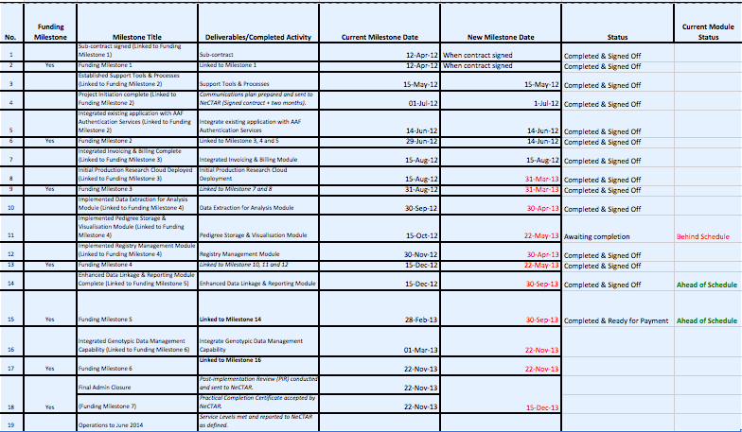
Updated schedule progress

Slide 7
Project Report - Financial
Total project budget: $614,490
Total NeCTAR contribution: $289,000 (note revised down from initial request)
Total co-investment: $324,965
Funds received to-date $156,000
See attached financial report
A restructuring of funding milestones was made due to staffing and dependencies, we are awaiting the response, but were told all is in order. For now we are reporting against existing milestones and keeping on track for new milestones to ensure project completed.

Slide 8
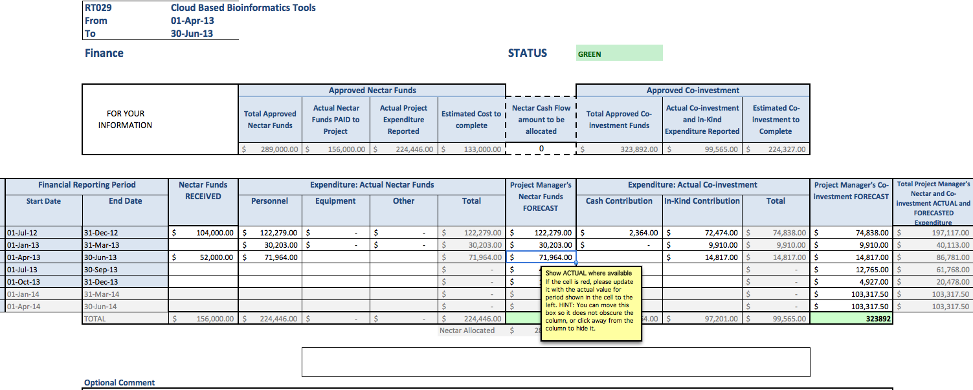
NeCTAR Financial Reporting

Slide 9
NeCTAR Reporting – Risks
Ark-628 | The impact of the reduced $ and delay of the GVL project on genomics storage is unknown | Genomic Data Repository (installed at UNSW) determined not to be suitable so will be developing a solution in-house. GVL project continues to be delayed. UWA staff developed a solution which bypassed GVL. Travis will do some research to check that GVL may be back as an option, and if timeline permits we can head back in that direction. The reduced dollars is obviously always a risk given that the original estimates are what they are and reducing dollars means reducing hours of developer time. | Amber
1 | Availability of appropriately skilled development resources. | One developer has been ill and may need extended sick leave. Have submitted an RFC to adjust milestone dates and have identified another part time develop to assist. Developer did take leave, cannot be sure of the future availability of developer, but as of today he is back. A tight timeline still exists, and part-time developer has not had the time available initially indicated to us. In the interim an increased output from some key members has allowed the project to make up for this shortfall as staff roll back into productivity. A member of UWA team took on an extra day a week and has worked significantly over time to get back on (revised) schedule. PhD student Thilina is also having to adjust his schedule to meet his writing and other needs, so his availability is a little less than originally thought but his productivity is still good at times he is available | Amber
2 | Ongoing availability of partner organisation resources. | Resourcing is not currently an issue. | Green
3 | Availability RDSI, AAF and the Research Cloud. | NSP stability is good. UWA will support use of UWA AAF services for production authentication. This is going well but we now have a lot of studies and data and will need more processing power. Travis to address this | Amber
4 | Completeness of configuration documentation for new studies | Pushing back on deployment dates to ensure clients have clearly documented their configuration requirements | Amber

Slide 10
Other Business
SPArk Grant to facilitate super computer analysis routines from within the ARK completed. Returned responses to evaluators questions.
Migrated 21 Studies from WARTN. One month of successful production use and positive responses
Despite great response, there is still work/requests in place as a result of increased use and testing.
Date for next meeting – mid September, 2013 to pre-empt report, or after report Mid October?
Travis and Adrian have been in talks and providing presentations with potential new users. Advice on how to reach out to others welcome.
We welcome suggestions on how this project can fund salaries to continue to expand and be used.
Update on proposed operational improvements from last meeting;

Slide 11
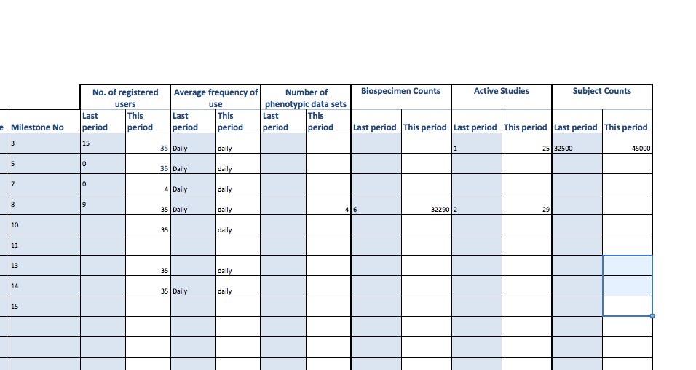
Some numbers

Slide 12
Approach Going Forward
Transparency – all projects and subcomponents will be estimated and tracked on Atlassian/JIRA.
Our actual users are actively using Atlassian and there is good communications on all matters.
We may still have an image issue from previous promises on dates not being met. This transparency and the strict policy on honest, transparent evaluation is working to fix that.

Slide 13
Approach Going Forward
Prioritization – this project is already at or beyond full capacity. Feature requests are welcomed via the JIRA system. However, everything will need to be prioritized.
We have been making great progress on fixing what needs to be fixed and users have been great accepting the need of prioritization and evaluating needs and wants. The projects is catching up on timelines as a result and users are very happy.

Slide 14
Approach Going Forward
Knowledge Sharing and Documentation
Have been doing our best at communicating, but we still need a period to formalize a lot of processes
This still has a lot of work to go

